Slide 1
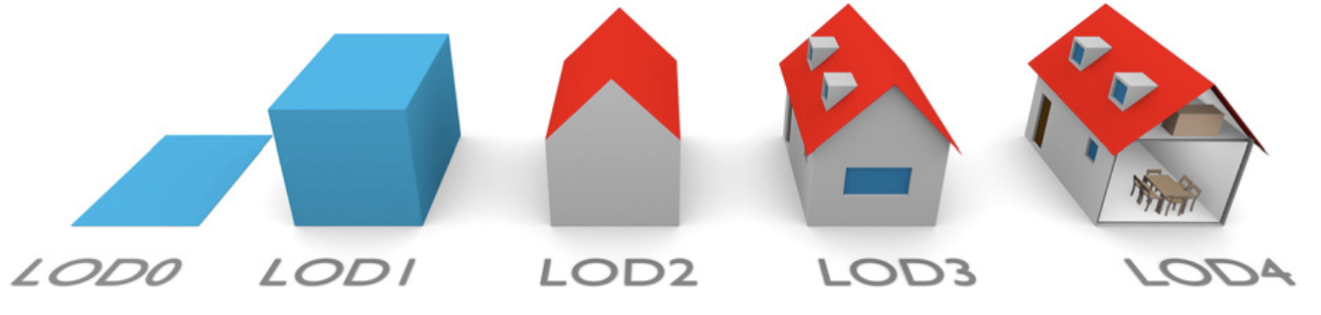
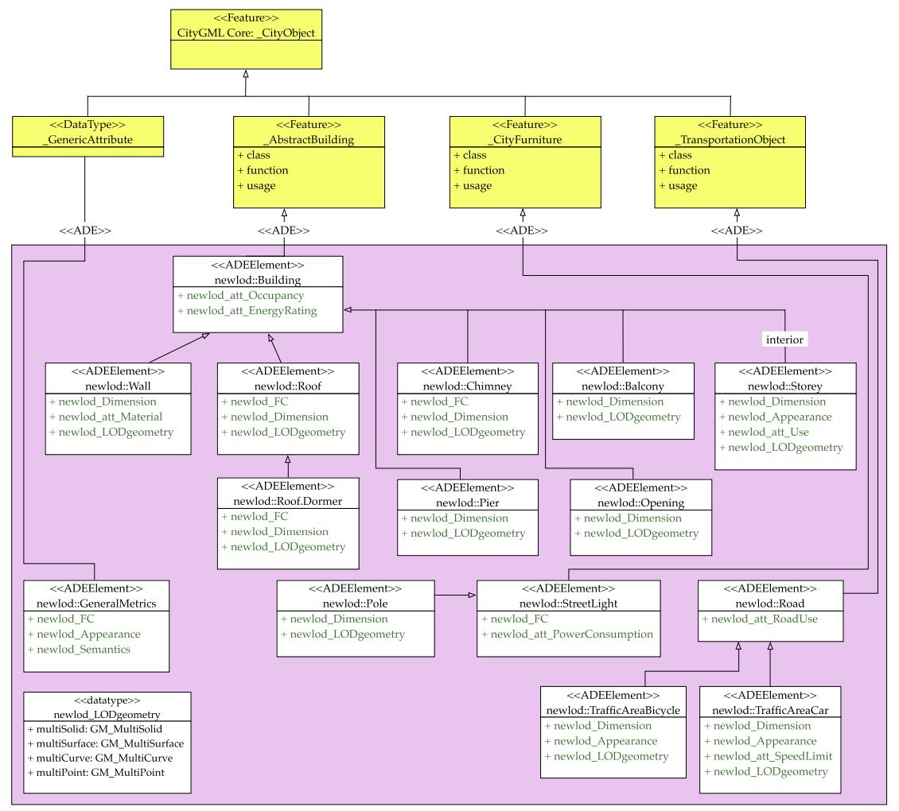
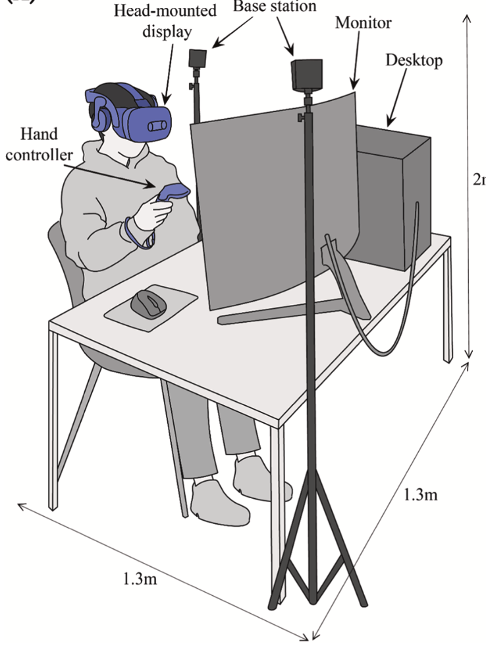
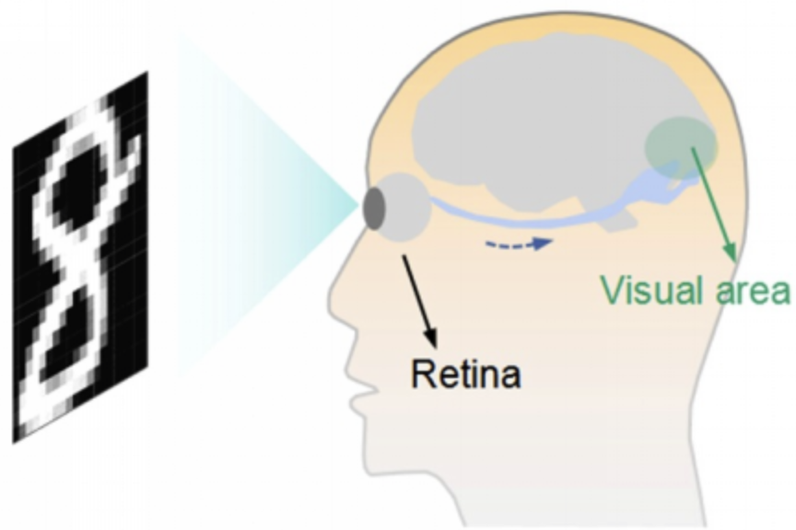
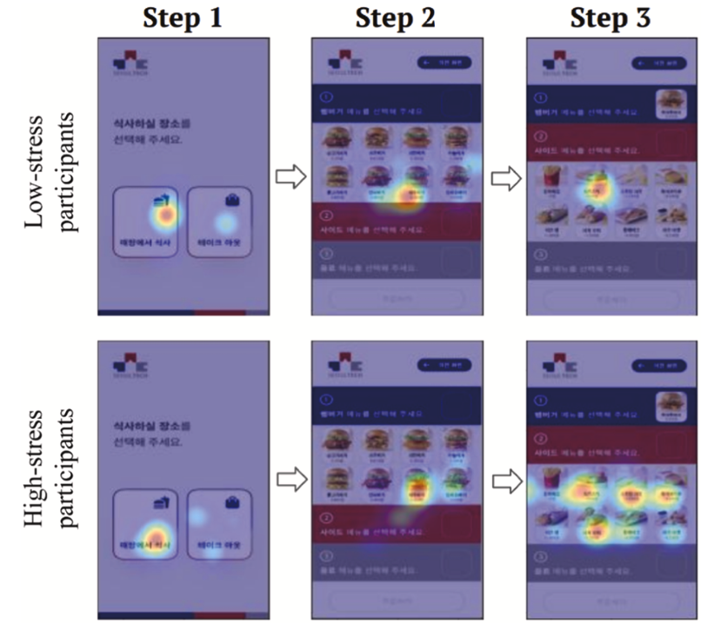
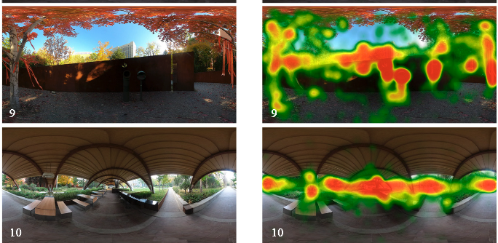
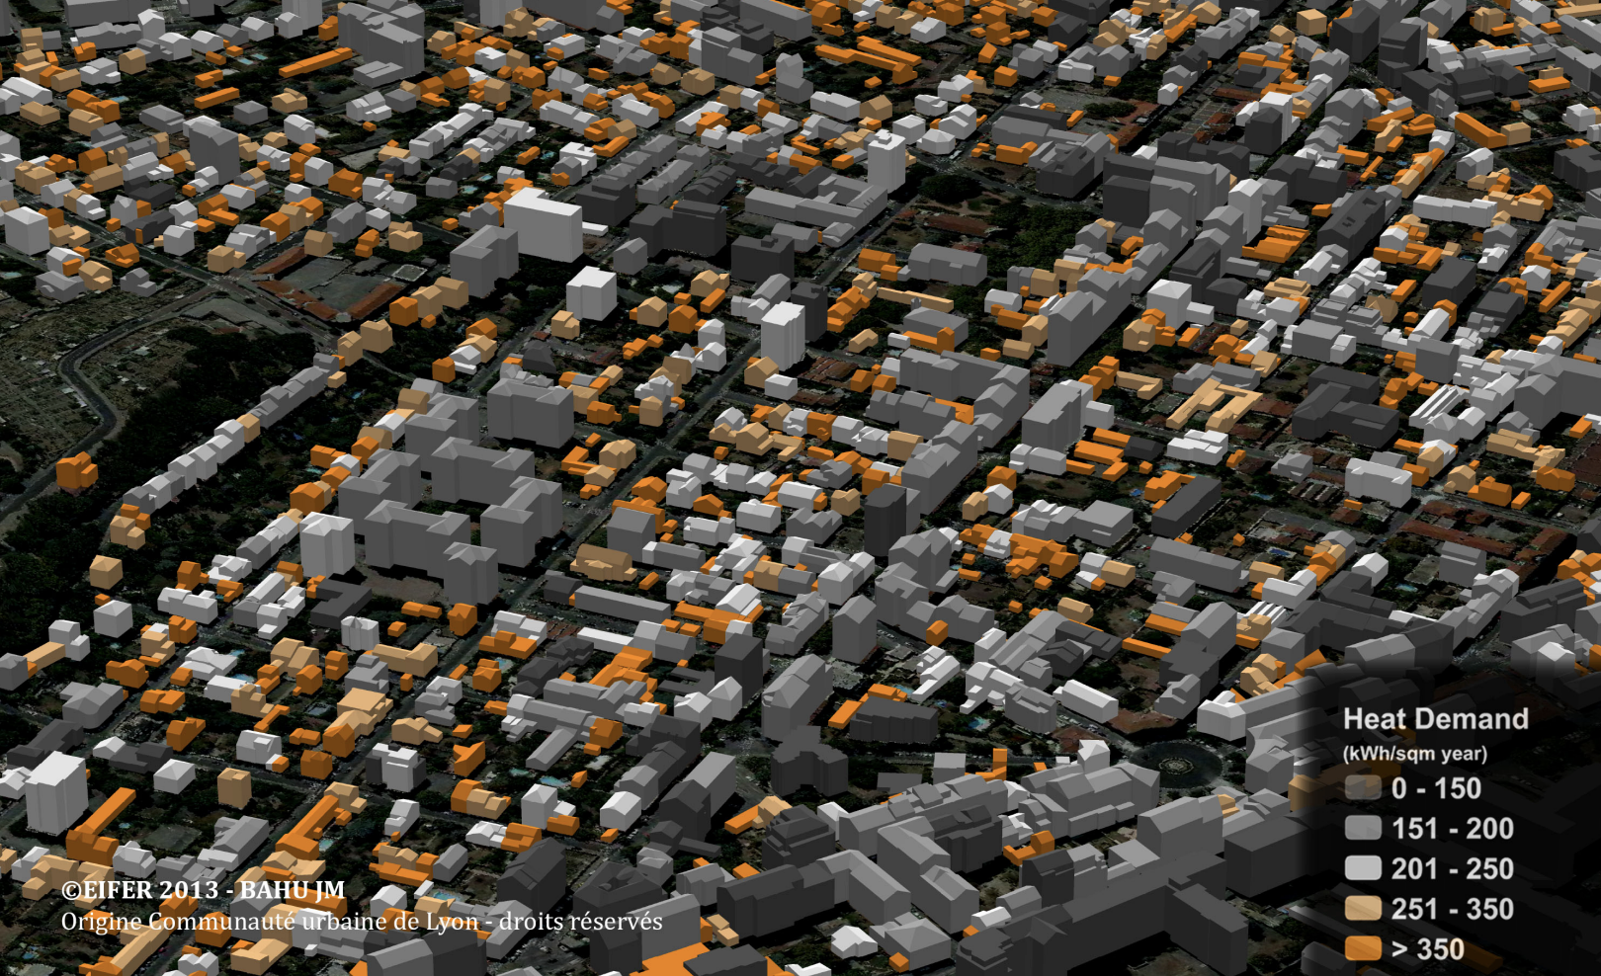
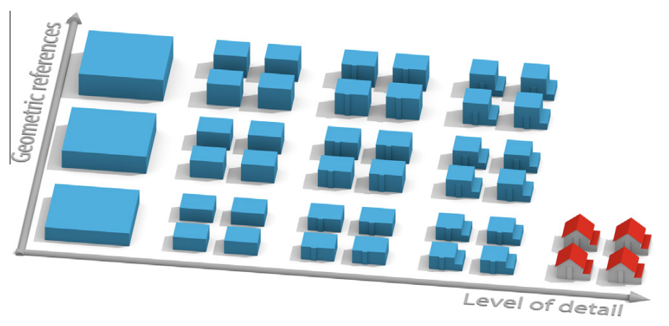
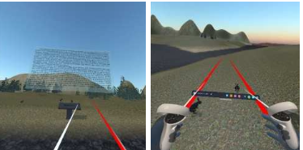
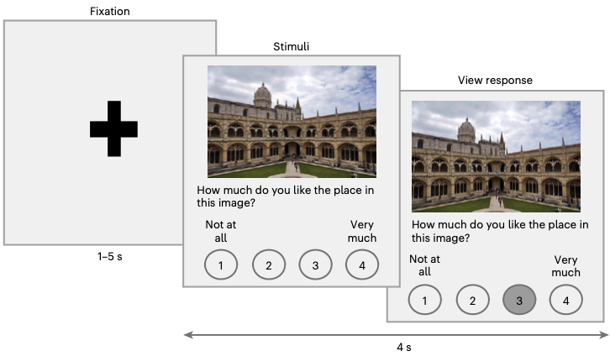
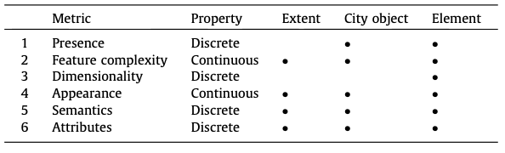
Rethinking Realism Through Human Behavior in VR city modeling LOD Design
Background:
static, discrete LOD for technical rendering efficiency
VR eye-tracking for urban & cognitive studies
LOD in CityGML 2.0 (Web)
UML graph for
CityGML Domain Extension
cognitive load experiment
VR set
eye-tracking
analysis
Web-based LOD application
relationship between
geometric reference and LOD
immersive application
human perspective survey
improvement of LOD concept (semantics and attributes added)

Slide 2
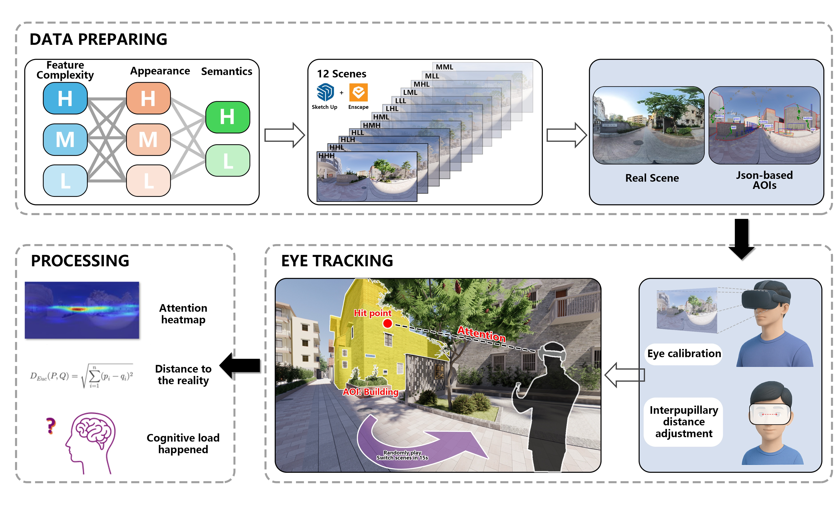
Rethinking Realism Through Human Behavior in VR city modeling LOD Design
Objective:
Find the most authentic combination of Feature Complexity, Appearance, and Semantics in VR city modeling;
and propose a perception-oriented LOD framework that utilizes gaze distribution as a primary metric
Method:
Develop an android VR application on PICO to extract human behavior
Design 13 sets of scenes (different combinations of Feature Complexity, Appearance, and Semantics)
Classify eye movement data based on AOI → Calculate the proportion in each AOI category
Use multiple indicators to calculate distribution differences: Euclidean Distance, Cosine, Divergence, ARE, Proportional Similarity

Slide 3
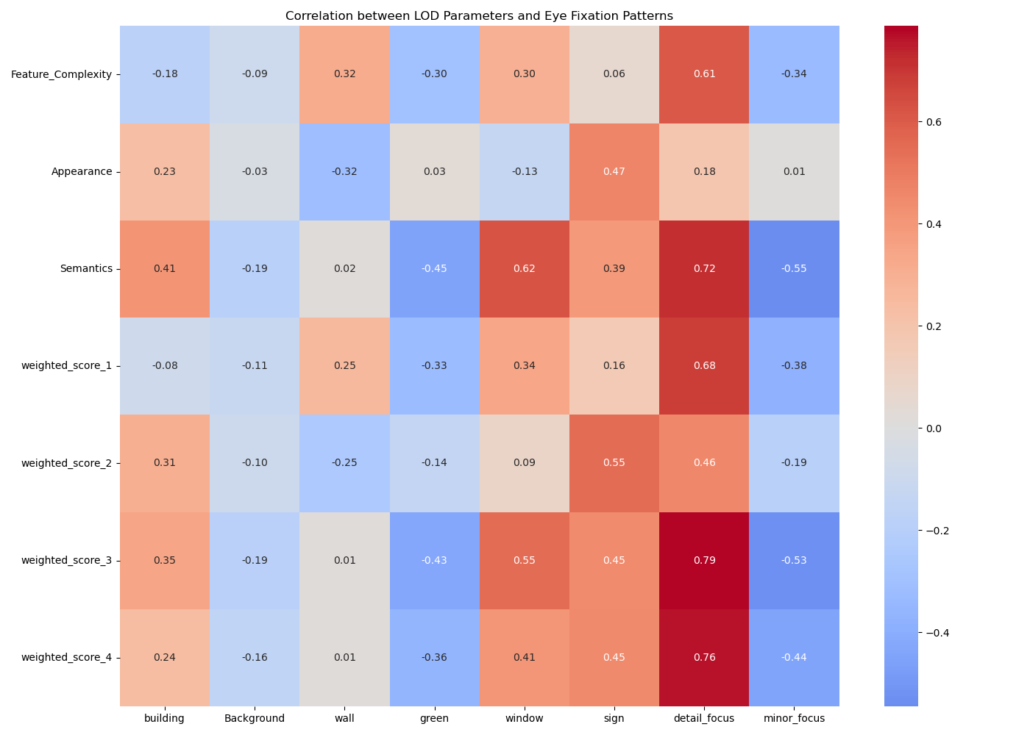
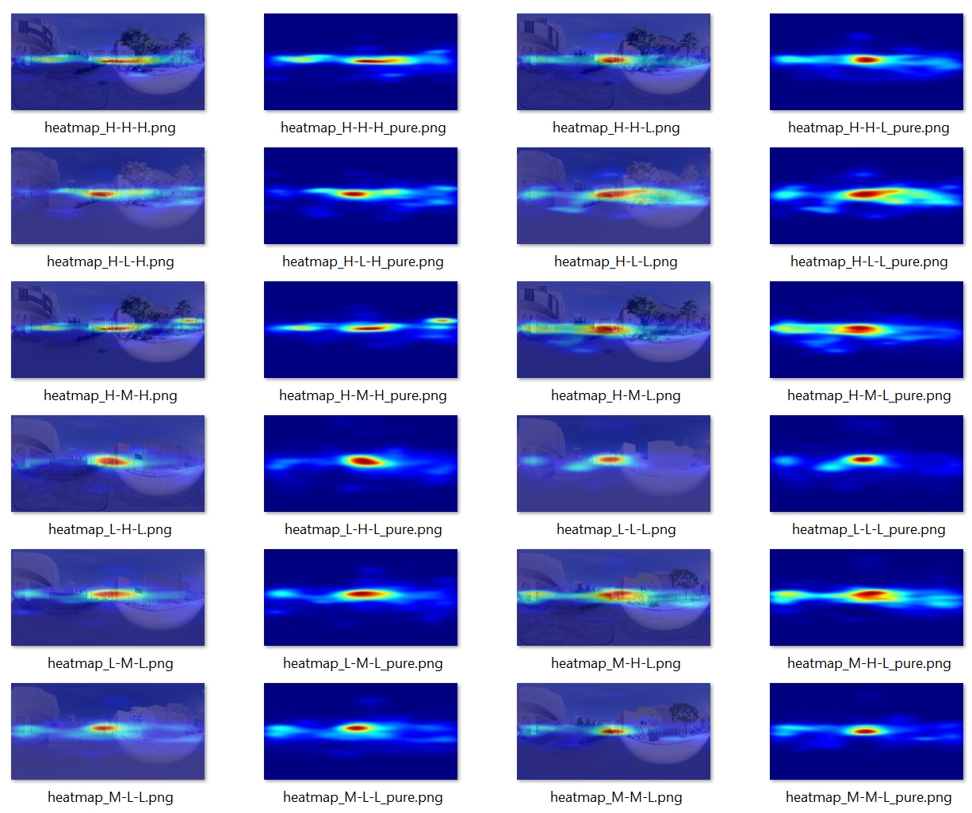

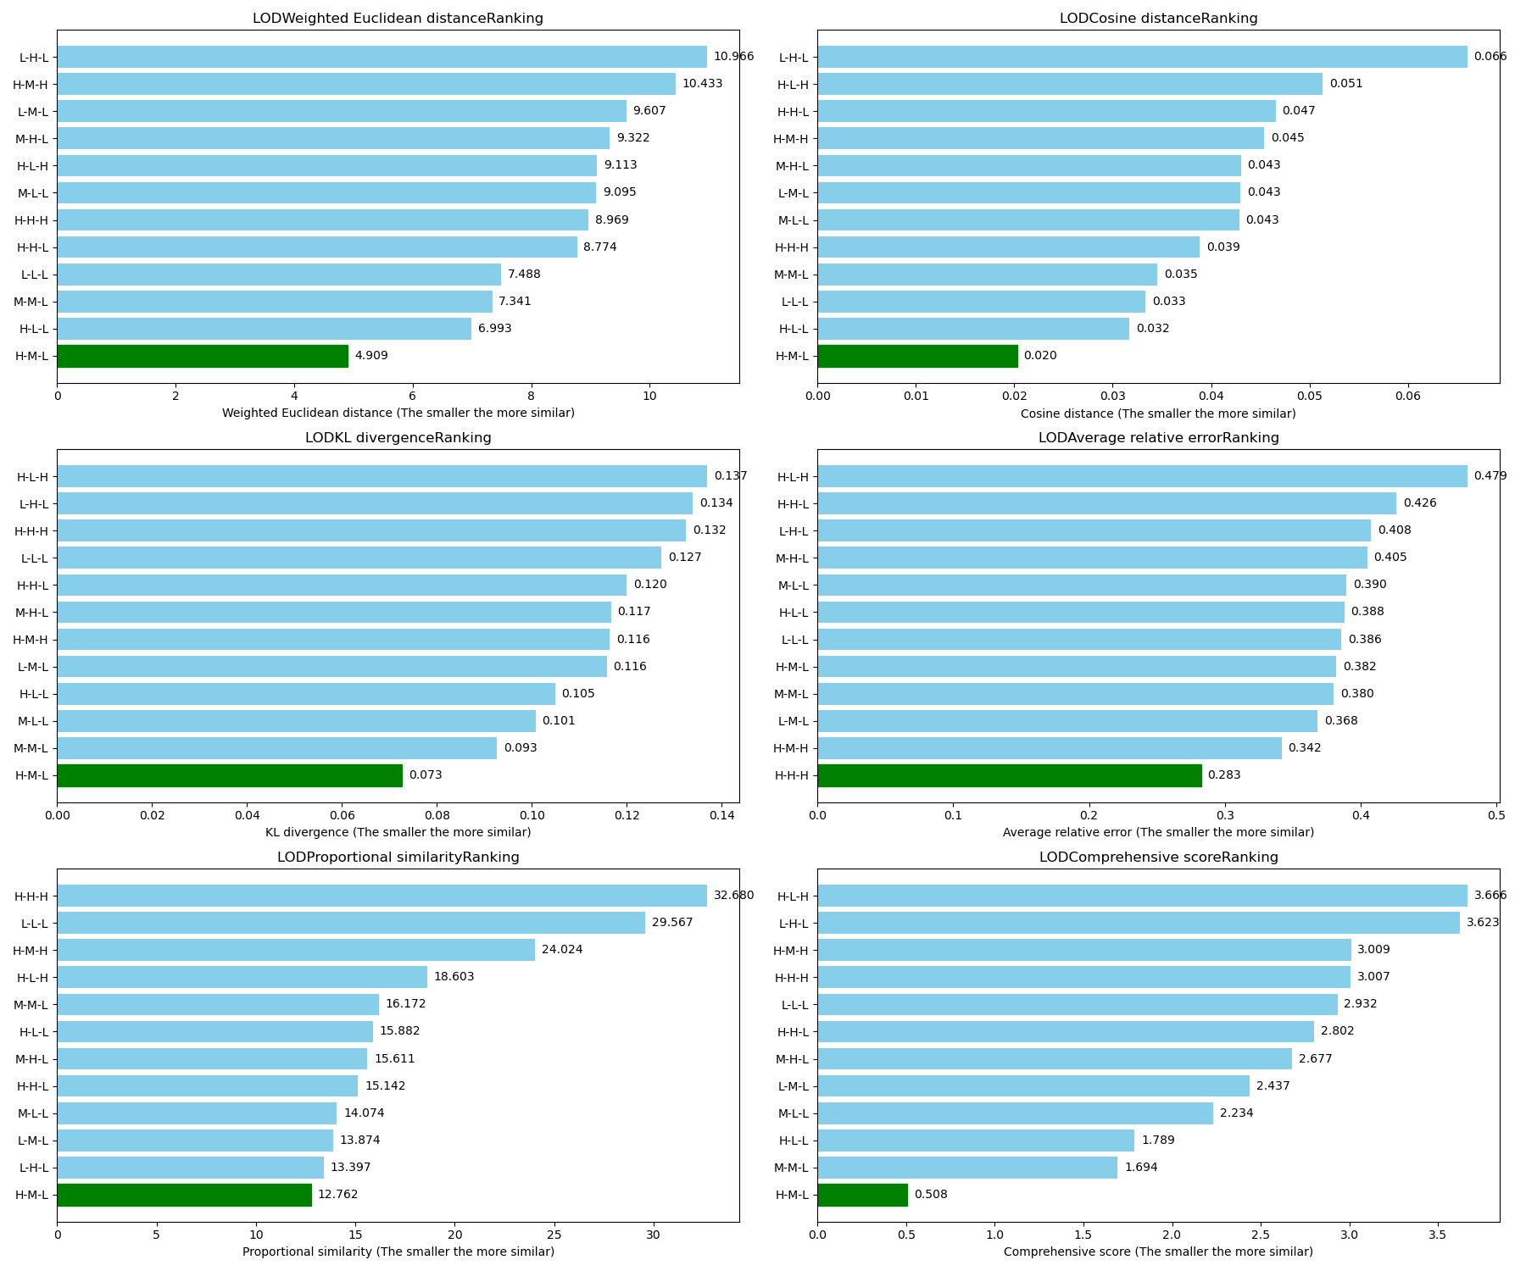
Rethinking Realism Through Human Behavior in VR city modeling LOD Design
LOD has a significant impact on gaze distribution.
The gaze distribution of semantically related AOIs (window, sign, door, etc.) is significantly correlated with semantic intensity.
The HML(High Feature Complexity, Mid Appearance, Low Semantic) configuration is closest to Real in terms of comprehensive distance.

